Slide 1
SkillSwap: Student Skill Exchange Platform
Submitted By
G V H S YAJWIN
24KT1A05O8
3-1 CSE D

Slide 2
Abstract
SkillSwap is a responsive MERN stack web application designed for peer-to-peer student learning. Students can register using their college details, list the skills they can teach, and explore skills shared by other students.
The platform allows students to search and filter skills, send skill exchange requests, and accept or reject incoming requests. It uses MongoDB for data storage, Express.js and Node.js for backend services, and React.js for the user interface.

Slide 3
INTRODUCTION
Students often want to learn practical skills from peers but may not know who on campus can teach a particular skill.
SkillSwap provides a common platform where students can share the skills they know and discover skills offered by others.
Students register with college details and create skill listings describing what they can teach.
Other students can search and filter the available skills and send exchange requests.
The receiver can review requests and accept or reject them through the My Requests page.

Slide 4
Existing system
Students commonly depend on informal peer networks to find someone who can teach a particular skill.
Skill information is scattered across personal contacts and student groups.
There is no single place to list skills that students are willing to teach.
Finding a student with a specific skill can take time.
Skill exchange arrangements are often handled through separate conversations.
Students may not have a clear view of incoming and outgoing exchange requests.

Slide 5
Existing System Limitations
Skill information is scattered across different communication channels
Difficult to discover students by skill or category
No central listing of skills offered by students
No structured skill exchange request workflow
Incoming and outgoing requests are difficult to track
No single dashboard for a student's skill and request activity

Slide 6
PROPOSED SYSTEM
Central platform for student-to-student skill exchange
Students register using college details
Students list the skills they can teach
Other students explore, search, and filter skill listings
Students send skill exchange requests to listing owners
Receivers can accept or reject incoming requests
Dashboard displays skill and request statistics
Profile details can be viewed and updated

Slide 7
Software Requirements
Operating System: Windows / Linux / macOS
Frontend: React.js with Vite
Backend: Node.js with Express.js
Database: MongoDB Atlas
ODM: Mongoose
API Communication: Axios
Development Tools: Visual Studio Code
Browser: Google Chrome / Mozilla Firefox

Slide 8
Libraries
Frontend Libraries
React.js – Component-based UI development
React Router DOM – Client-side routing
Axios – API communication between frontend and backend
Backend Libraries
Express.js – Backend framework for REST APIs
Mongoose – MongoDB object data modeling
bcryptjs – Password hashing and verification
express-session – Session-based authentication
cors – Cross-Origin Resource Sharing
cookie-parser – Cookie handling
dotenv – Environment variable configuration

Slide 9
Modules of the Project
1. Authentication Module
Student registration and login
Passwords hashed using bcryptjs
Session-based authentication using express-session
2. Student Profile Module
Stores college and student details
Allows logged-in students to view and update profile
3. Skill Management Module
Students add, update, view, and delete their own skill listings

Slide 10
4. Explore Skills Module
Displays skill listings from students
Supports search, category filter, sorting, and limit
5. Skill Exchange Request Module
Students send exchange requests
Receivers view incoming requests and accept or reject them
6. Dashboard Module
Displays skill and request statistics
Uses MongoDB aggregation for counts and status groups

Slide 11
7. REST API Module
Provides endpoints for authentication, skills, requests, profile, and dashboard
Uses GET, POST, PUT, and DELETE methods
Supports route parameters and query parameters

Slide 12
Modules Description
Authentication Module: Registers students, verifies login credentials, hashes passwords using bcryptjs, and maintains sessions.
Student Profile Module: Retrieves and updates the logged-in student's profile details.
Skill Management Module: Allows students to create, view, update, and delete their own skill listings.
Explore Skills Module: Retrieves skill listings and supports search, category filtering, sorting, and limiting.
Request Module: Creates exchange requests and allows receivers to accept or reject incoming requests.
Dashboard Module: Uses MongoDB aggregation to calculate skill counts and request status statistics.

Slide 13
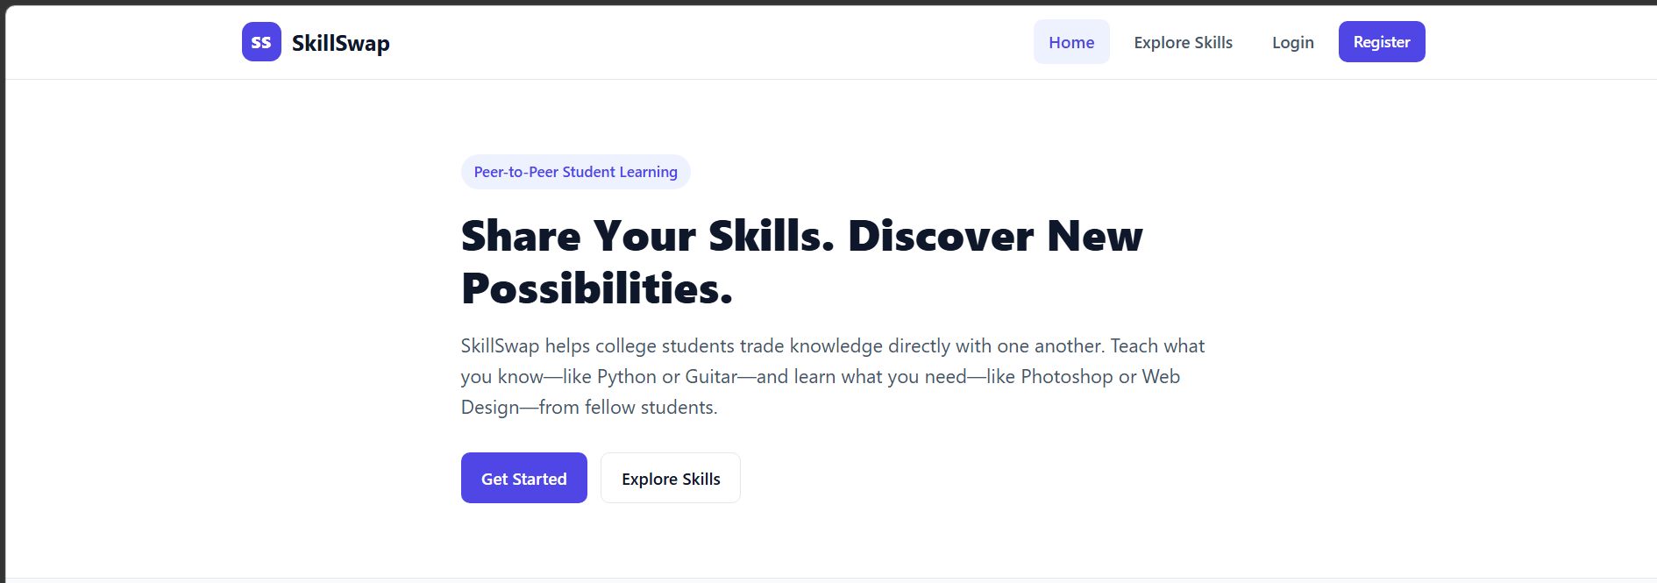
wEBSITE Screenshots

Slide 14
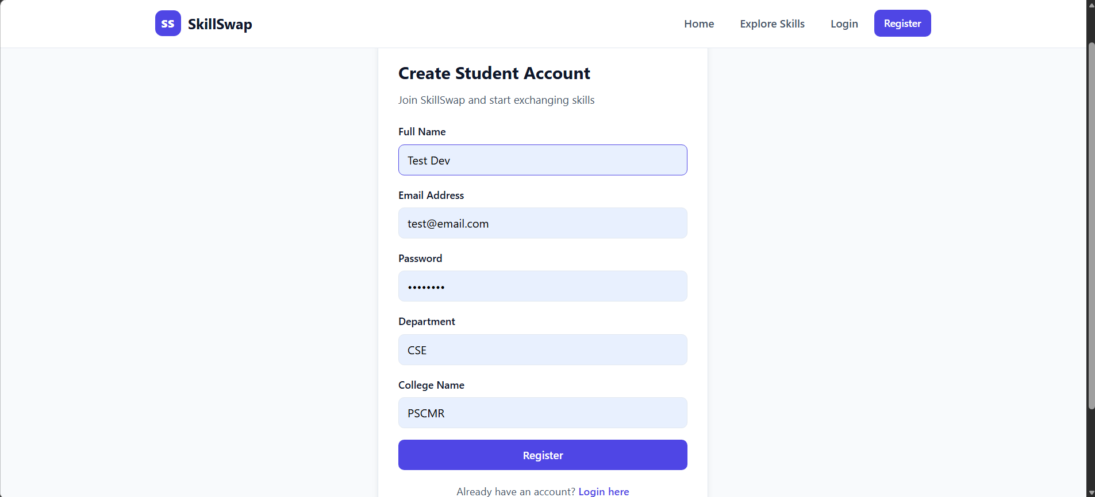

Slide 15
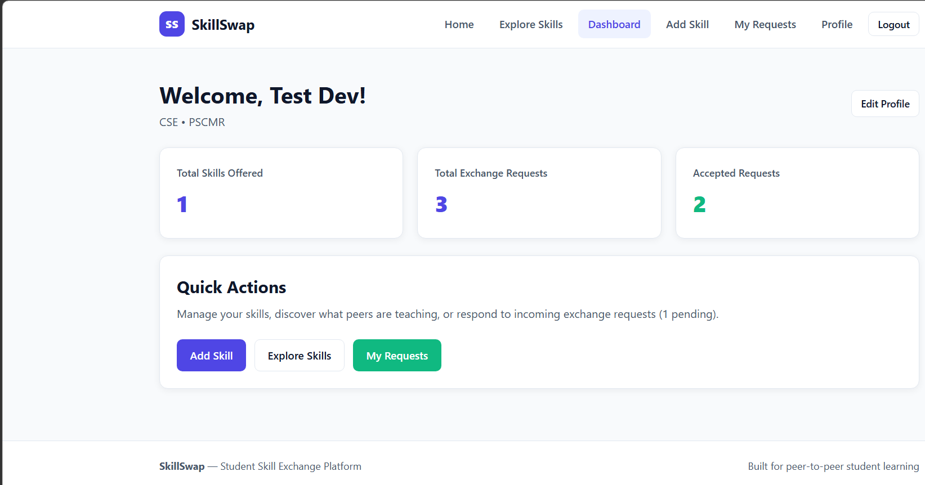

Slide 16
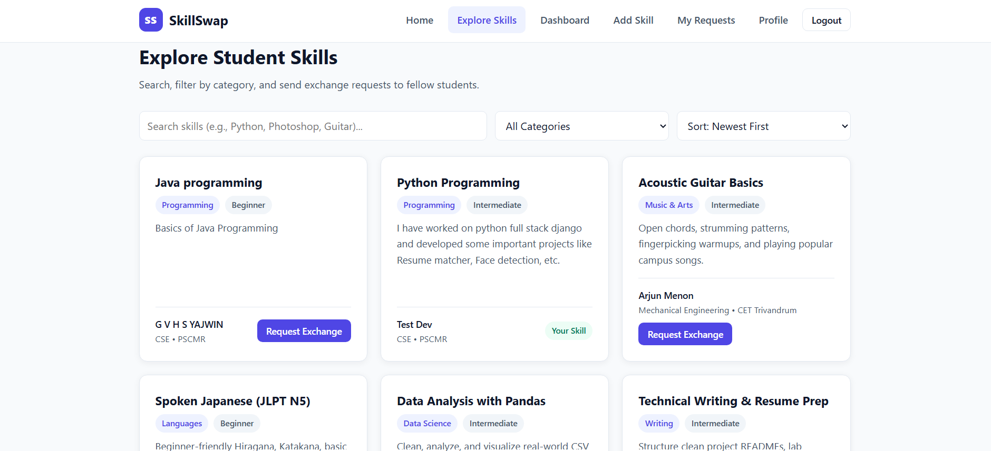

Slide 17
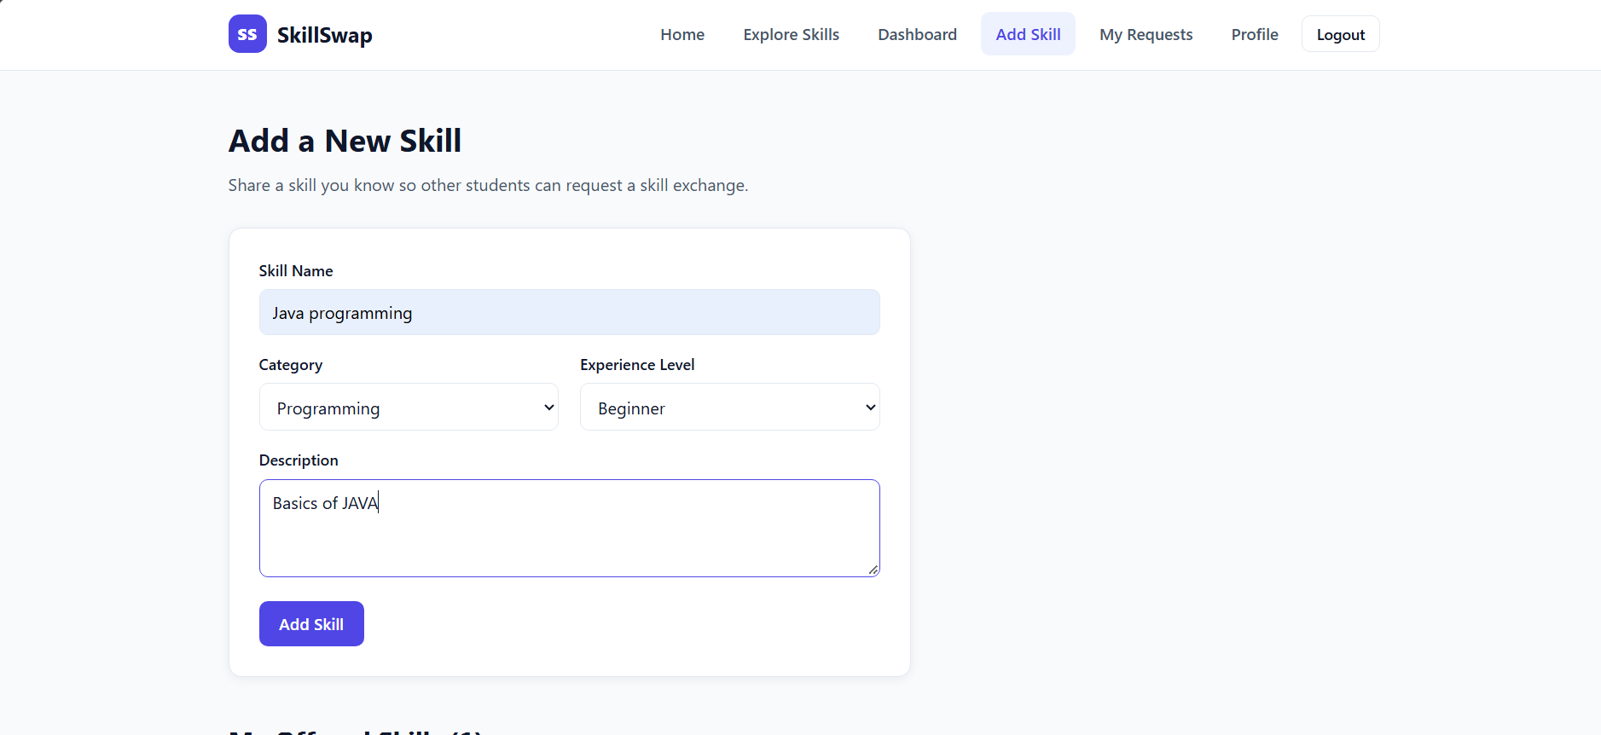

Slide 18
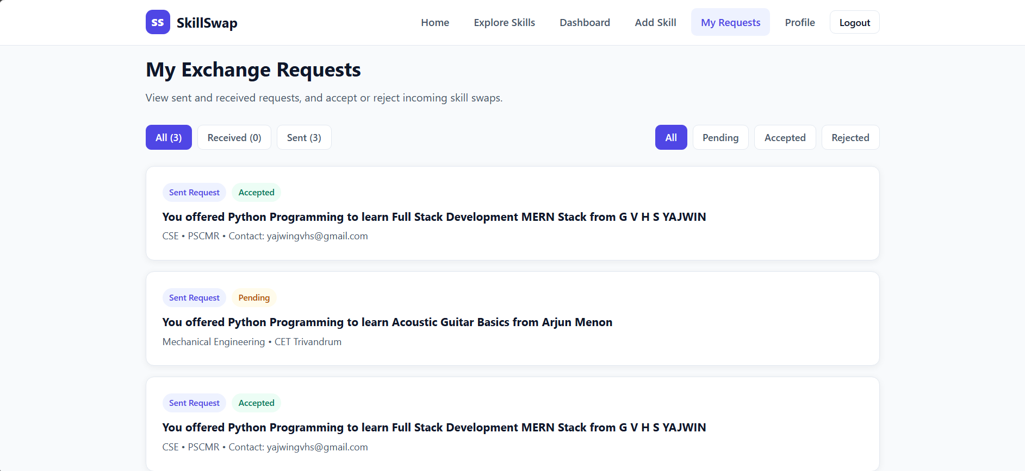

Slide 19
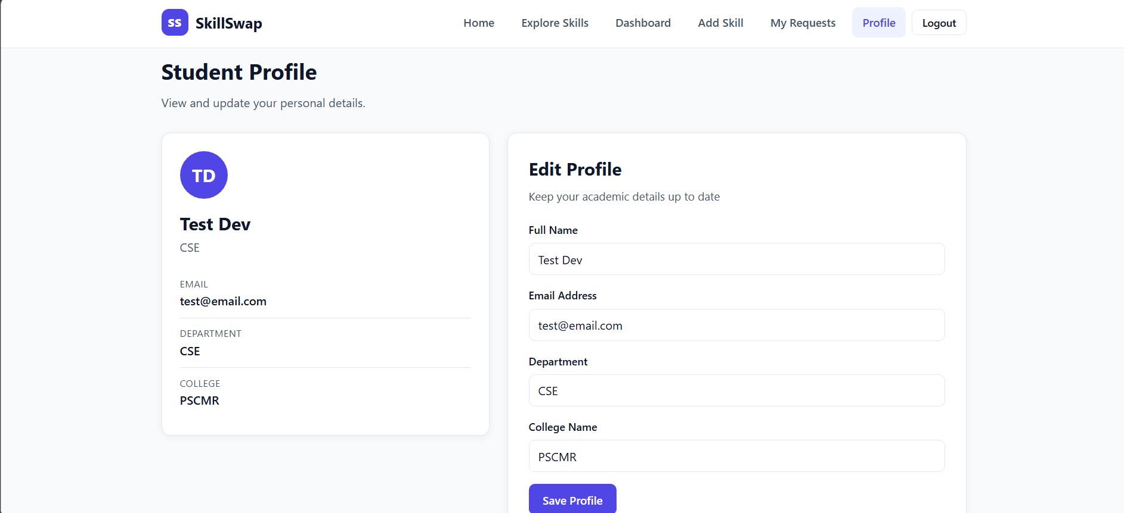

Slide 20
Conclusion
SkillSwap provides a common platform for students to share skills and learn from one another. Students can register, publish skills they can teach, explore listings, and send skill exchange requests. The platform supports request acceptance or rejection, profile management, and dashboard statistics. The project demonstrates the use of the MERN stack, REST APIs, MongoDB data operations, React components, and session-based authentication.

Slide 21
Thank You

